Slide 1
In memory detection of Windows API call hooking technique
S. Z. Mohd Shaid
Fac. of Comput., Univ. Teknol. Malaysia, Johor Bahru, Malaysia
M. A. Maarof
Computer, Communications, and Control Technology (I4CT), 2015 International Conference on

Slide 2
What is API ? (Application Programming Interface)

Slide 3
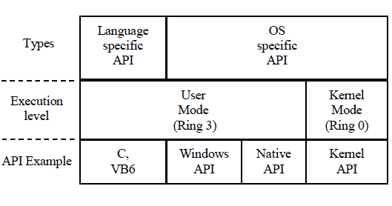
APIs in Windows OS

Slide 4
What is API Hooking ?

Slide 5
Existing Windows API Hooking on user mode
IAT Hooking
Debugger Hooking
Inline Hooking

Slide 6
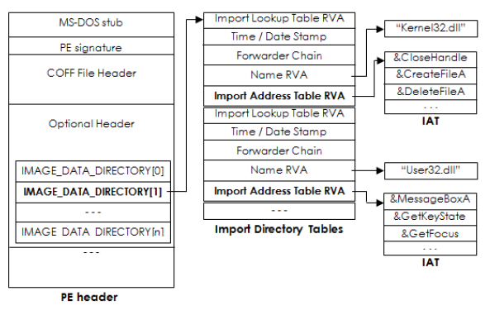
IAT Hooking

Slide 7
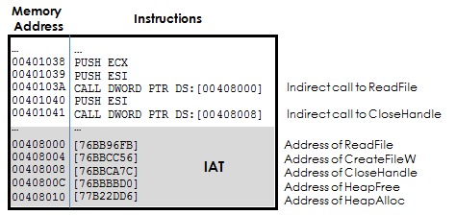
IAT Hooking

Slide 8
Debugger Hooking
works by running a debugger that ‘debugs’ a target application.
achieved by having the debugger placing a breakpoint at the entry point of an API.

Slide 9
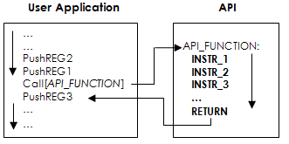
Inline Hooking

Slide 10
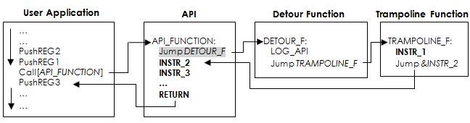
Inline Hooking

Slide 11
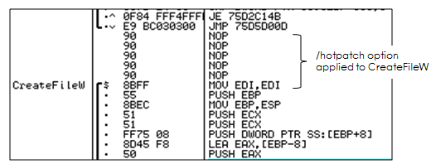
Inline Hooking

Slide 12
Inline Hooking

Slide 13
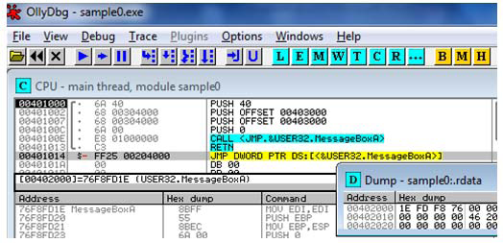
Findings on IAT Hooking

Slide 14
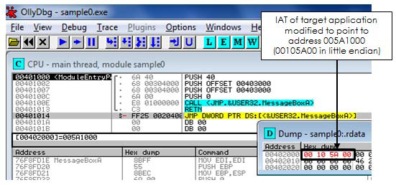
Findings on IAT Hooking

Slide 15
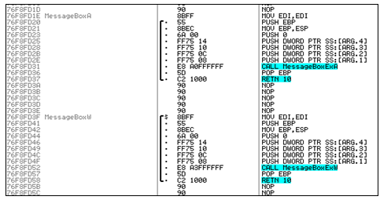
Findings on Debugger Hooking

Slide 16
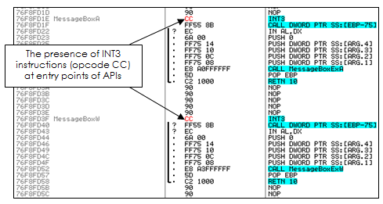
Findings on Debugger Hooking

Slide 17
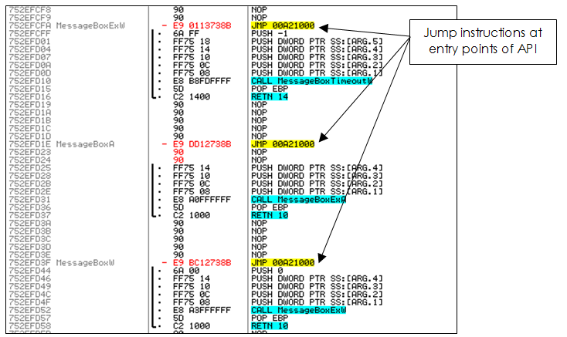
Findings on Inline Hooking

Slide 18
Findings on Inline Hooking

Slide 19
ANALYSIS OF EXISTING TECHNIQUES
IAT Hooking:
changes are guaranteed to be made to the PE’s
IAT.
not being able to capture dynamically loaded API.
it is possible for malware to bypass an IAT
hook altogether through dynamic invocation of API calls.

Slide 20
ANALYSIS OF EXISTING TECHNIQUES
Debugger Hooking:
changes that it made to the execution environment made it.
The use of a predictable instruction at the entry
point of API means that malware could do
a simple if-else comparison to detect the present of breakpoints.

Slide 21
ANALYSIS OF EXISTING TECHNIQUES
Inline Hooking:
have the potential to be upgraded into a better API hooking technique.
an obfuscated code for code redirection would yield better stealth.

Slide 22
CONCLUSION
must not make predictable changes.
must be able to redirect code execution.

Slide 23
Q&A

Slide 24
Thank you

